Slide 1
CPE 404
Computer Hardware Design
Dr Osama Hosameldeen
Spring 2021
Lecture 8
Registers and Counters

Slide 2
Topics
Definition of Register and Counter
Registers, Shift Registers
Ripple Counters
Synchronous Binary Counters
BCD Counters
Notes:
School of Engineering

Slide 3
Registers

Slide 4
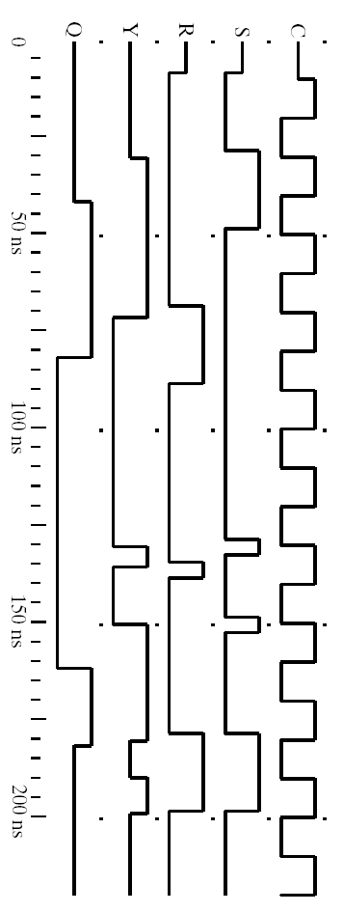
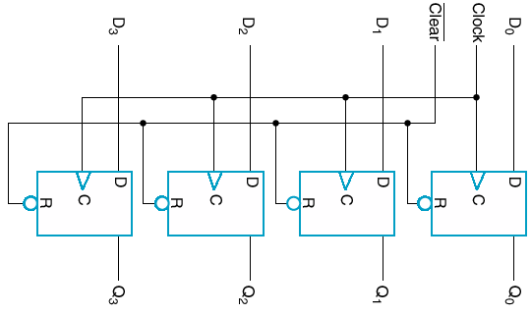
Registers: Definition
Register – a set of flip-flops
  May include extensive logic to control state transition
  Registers also referred to as fast memory for storing data in a computer
Inputs D0,D1,D2, D3 are transferred to output

Slide 5
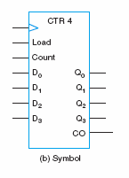
Counters: Definition
Counters
  Are registers that go through sequence of states as it is clocked
  We designed a simple counter in the previous lecture using T Flip Flops!
000
001
010
011
111
110
101
100

Slide 6
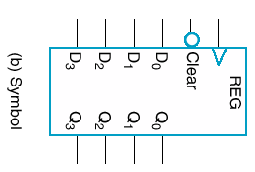
Simple Register (No External Gates)
Inputs
Outputs
Functionality
  Store D (D₀,D₁,D₂,D₃)
  On pos-edge of Clock
Clear signal sets output to zero
  Power-up reset

Slide 7
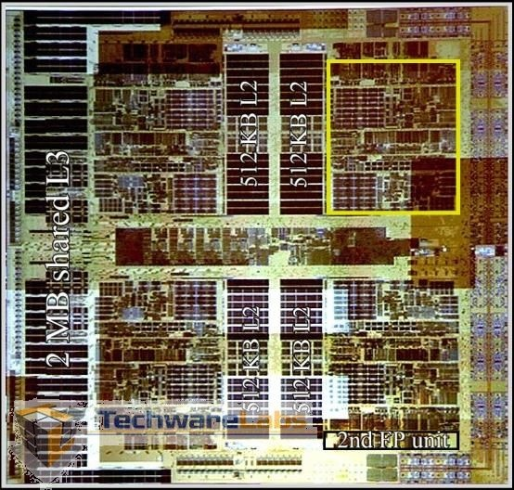
Computer Systems
Structure
  A memory for storing program and data.
    The memory consists of the word with the same length
  Central Processing Unit (CPU):
    A control unit (control path) featuring a program counter for controlling program execution
    An arithmetic and logic unit (ALU) also called data path for program execution
Program Counter
Processor or
Central processing unit
Memory
Datapath
Data
and
Instructions
Data
Registers
Control Path
Address
register
Instruction
register
PC
Address
Notes:
School of Engineering

Slide 8
Disabling the Clocking

Slide 9

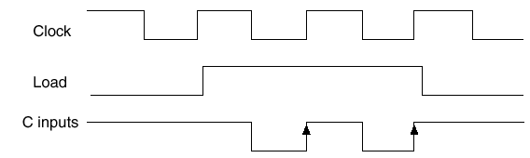
Clocking
The transfer of new info into a register is referred to as loading the register.
Typically we don’t want to load every clock
We gate the clock!! (Disable the clock)!!
We try to avoid gating!! (Timing issues)
  Alternatives to gating??
Disable the Clock

Slide 10
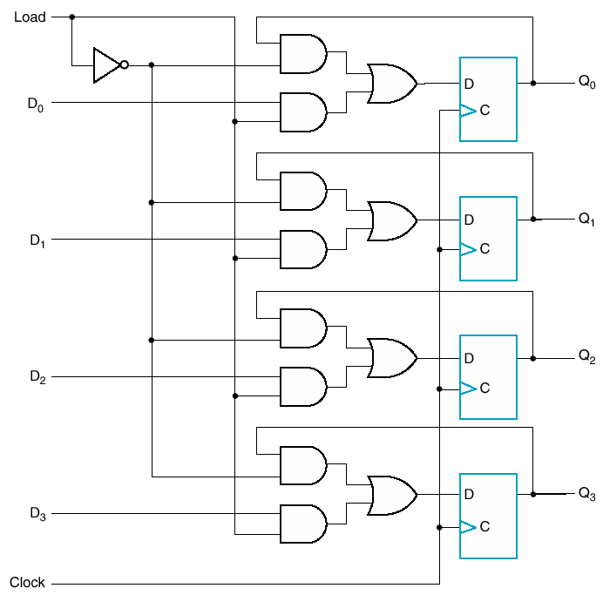
Alternative
If load ‘H’, then D goes through
Otherwise, Q is fed back
  Keep same value
No clock gating
Why add all this logic?
Because D FF doesn’t have “no change” behavior

Slide 11
Shift Registers

Slide 12
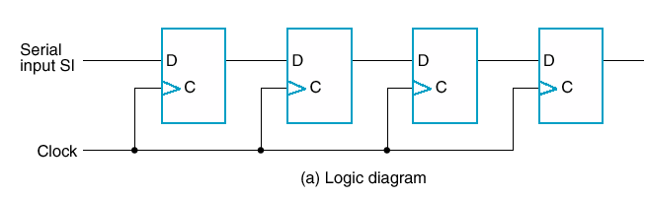
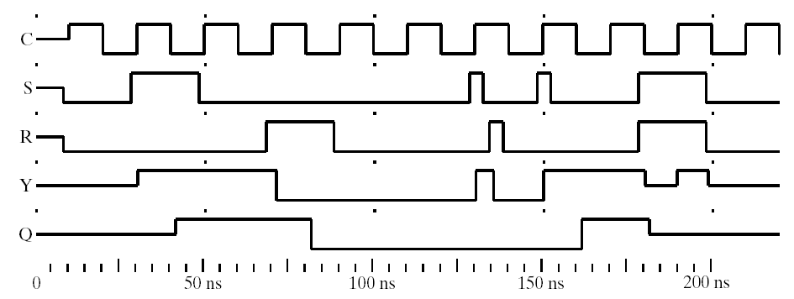
Shift Registers
A shift register is a chain of flip-flops in cascade, with the output of one flip-flop connected to the input of the next flip-flop.
Shift registers are capable of shifting its stored bits laterally in one or both directions.
All flip-flops receive a common clock pulse, which activates the shift from each stage to the next.
1
0
1
1
1
0
1
1

Slide 13
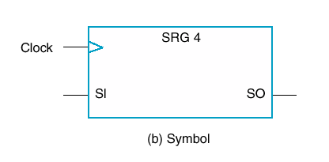
Simple 4-bit Shift Register
Every bit shifts to the right at every clock edge.
New information will enter via S_{i} and leave from S_{o}

Slide 14
Simple 4-Bit Shift Register: Diagram
Clocked in common
Just serial in and serial out
Q₀
Q₁
Q₂
Q₃
SO

Slide 15
Registers: Alternative Types

Slide 16
Bidirectional Shift Register
Shift either way (Left or Right)
Now we have following possible inputs
  Parallel load
  Shift from left
  Shift from right
  Also “no change”

Slide 17
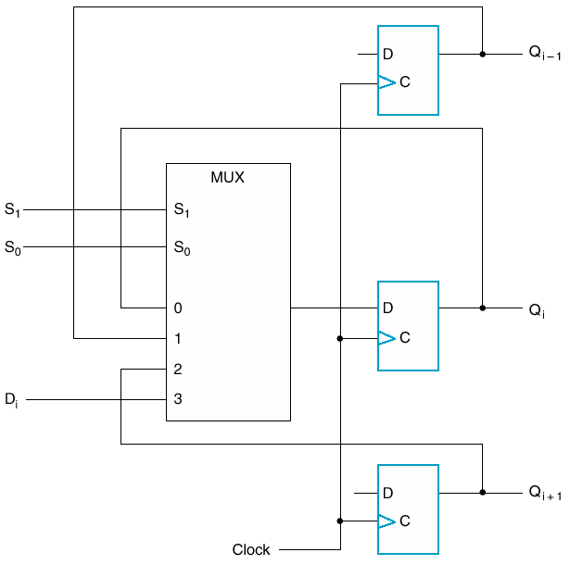
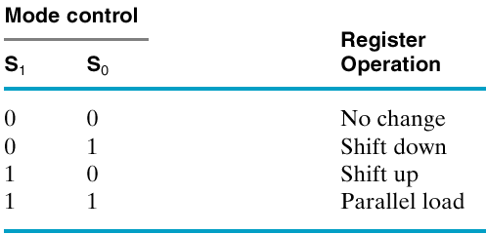
One stage of a bidirectional shift register with parallel load
Schematic

Slide 18
Shift Register with Parallel Load
Load any value to the shift register
The shift register can then shift information one bit at a time

Slide 19
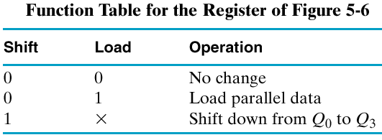
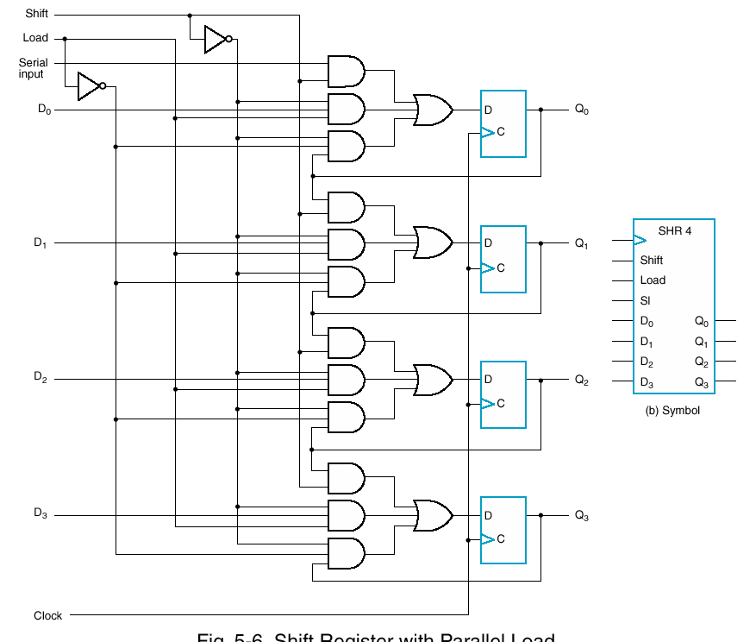
Schematic
Shift Register with Parallel Load

Slide 20
Shift Registers (Summary)
Capability to shift bits
  In one or both directions
Usage?
  Part of standard CPU instruction set
  Cheap Multiplication/Division
  Serial communications

Slide 21
Synchronous Counters

Slide 22
Counters
Counter is a register – but has states
Also goes through sequence of states – counts – on clock or other pulses
Examples:
Binary Counter
  Counts through binary sequence
  n bit counter counts from 0 to 2^{n} – 1
BCD Counter
Any Sequence Counter

Slide 23
Synthesis Using T Flip Flops
Design a counter that counts from “000” to “111” and then back to “000” again.
  Constraint: Use T Flip-Flops
Where do we start?
Start with a state diagram.

Slide 24
A Counter using T Flip Flops
“Synchronous Counters”
000
001
010
011
111
110
101
100
Create the State Table (use Excitation Table)
Minimize the Boolean function
Draw a circuit diagram

Slide 25
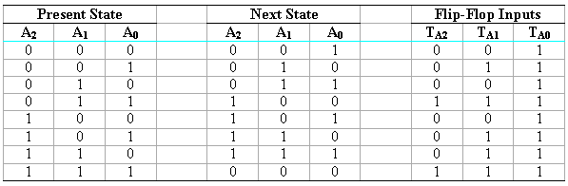
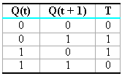
Example: T Flip Flop Synthesis
0
T_{A0} = 1
T_{A1} = ??
T_{A2} = ??

Slide 26
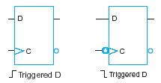

T Flip Flops “Synchronous”
By using K-maps we can minimize the flip flop input equations.
T
A₂
T
A₁
1
T
A₀

Slide 27
Asynchronous Counters

Slide 28
Asynchronous Counters
Asynchronous counters are yet another type of counters where not all flip flops are driven by the global clock.
Ripple counters are asynchronous counters that are easy to design.

Slide 29
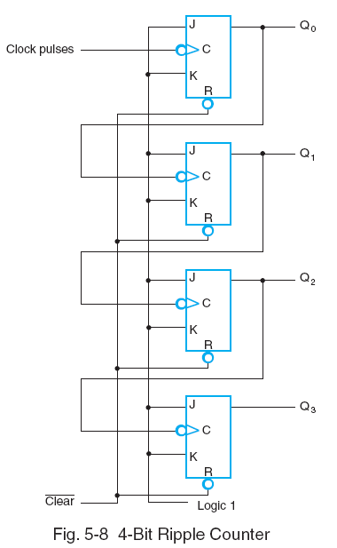
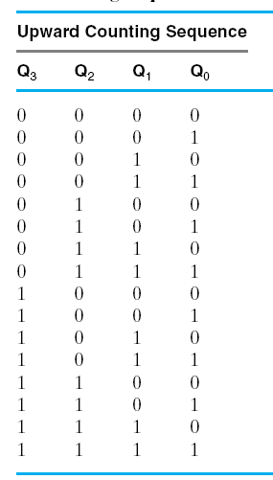
Ripple Counter Simple (Asynch)
Toggle

Slide 30
Counters with Parallel Load

Slide 31
Binary Counter with Parallel Load
Counters employed in digital systems quite often require a parallel-load capability for transferring an initial binary number into the counter prior to the counter operation.
When “load” is equal to 1, the input load control disables the count operation
It then causes a transfer of data from the four parallel inputs to the four outputs.
The carry output C0 becomes a 1 if all flip-flops are equal to 1 while the count input is enabled.
  This feature is useful for expanding the counter to more stages

Slide 32
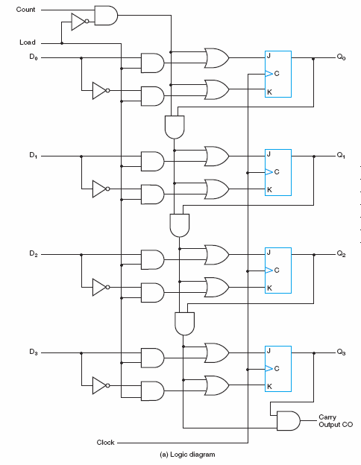

Slide 33
BCD Counters

Slide 34
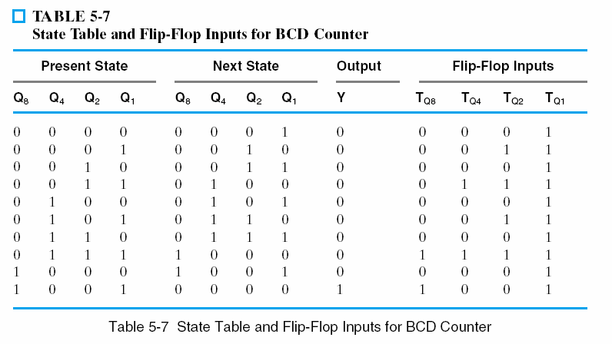
BCD Counters
BCD Counters can also be designed using individual flip-flops and gates
Design starts by
determining the logic
that drives each FF

Slide 35
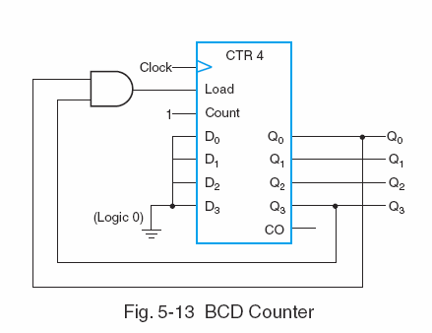
BCD Counter using Binary Counters
A “Binary Counter” can count from 0000 to 1111
The “Binary Counter” with parallel load can be converted into a synchronous BCD counter (How?)
By connecting an external AND gate to the load control (as shown in the Figure).

Slide 36
Arbitrary Counters

Slide 37
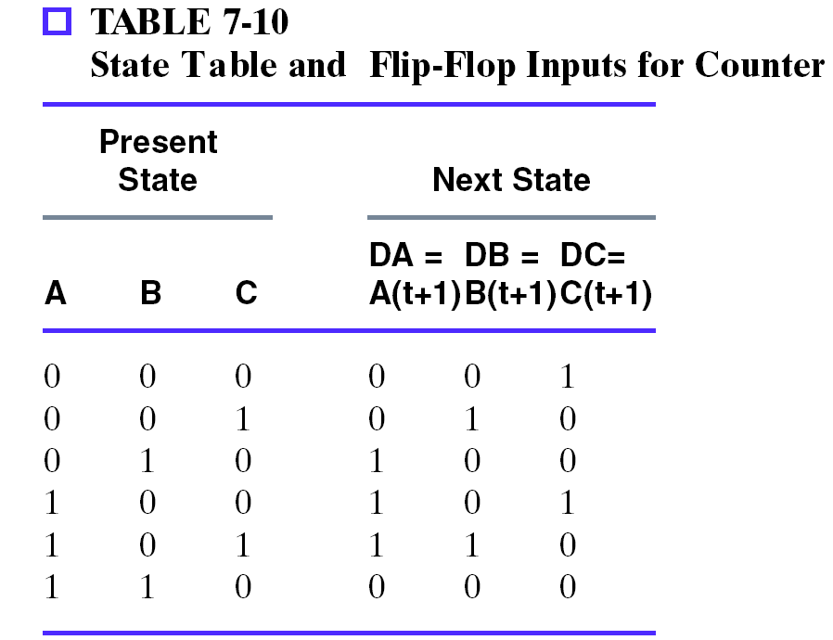
Arbitrary Count Sequence
One more type of counter is useful
Count an arbitrary sequence
  Maybe you need a sequence of states

Slide 38
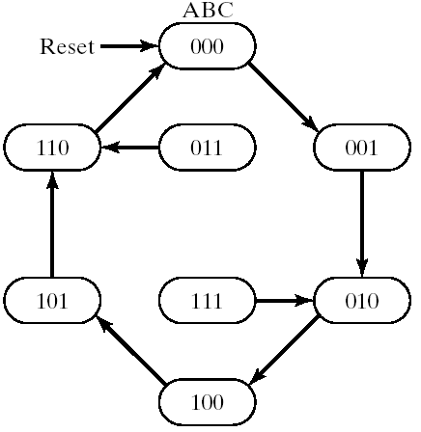
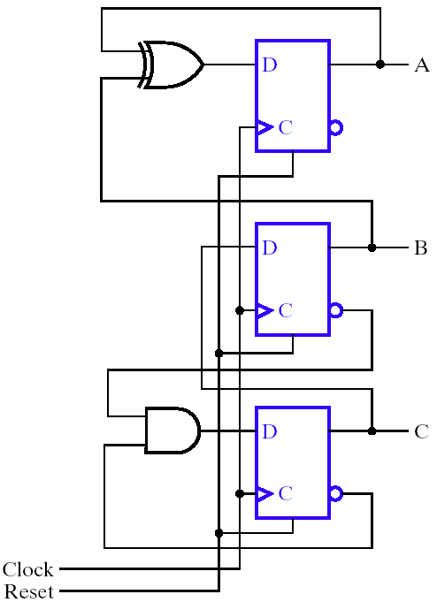
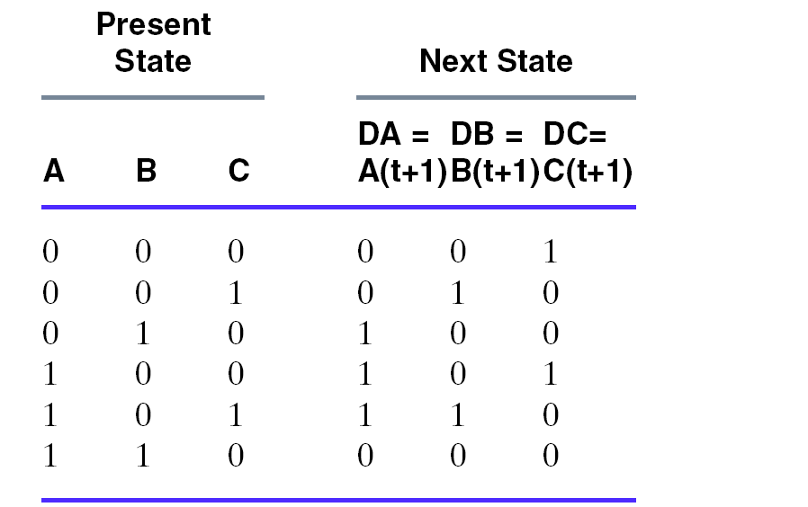
Circuit and State Diagram
Note the following two states are not considered
To be part of the state table. You can add them!
011
111

Slide 39
Applications: Serial Addition

Slide 40
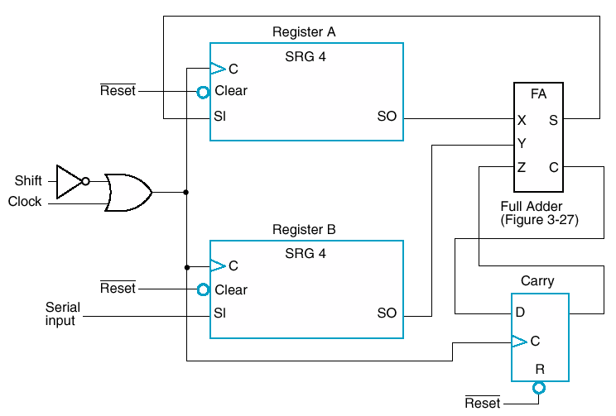
Serial Addition
Then shift through adder into A. Added to 0 if A is empty.
Initially reset all registers
0 1 0 0
Register A accumulates
0
0
0
0
0 0 0 1
Adds one bit at a time
At same time, new value going into B
0
0
0
0
0011 0001
0 0 1 1
Shift value in serially
Stores carry one clock

Slide 41
Hardware Comparison
Serial vs. parallel adder
  One full adder vs. n full adders
  Serial takes n clock cycles, parallel only one clock cycle
To reduce the amount of hardware to be mapped onto an FPGA designers seek to use alternative solutions:
  Serial Implementations.
  Semi Parallel Implementations
  Fully Parallel Implementations.

Slide 42
End Slides

Slide 43
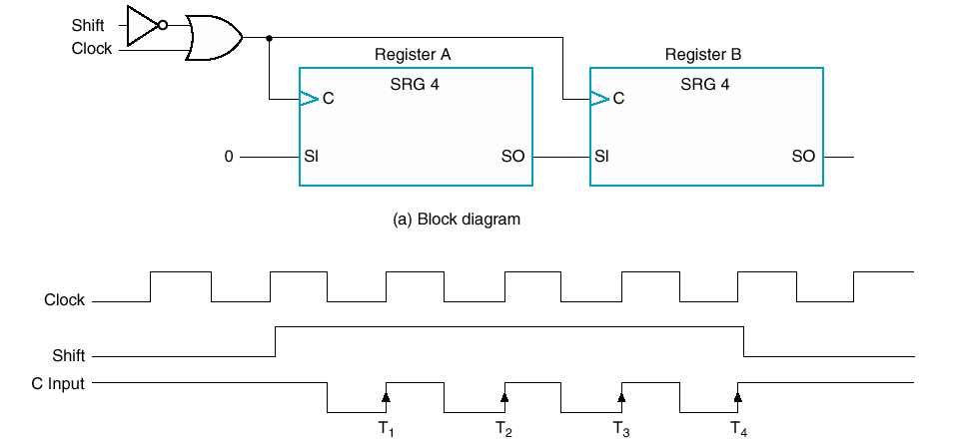
Serial Transfer (8-bit Shift Register)
Could shift data in
What’s on wire at each clock?
Clocked 4 times

Slide 44
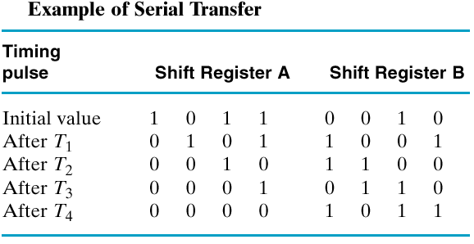
Table Showing Shift

Slide 45
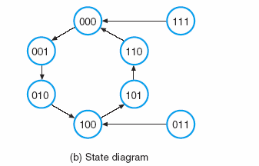
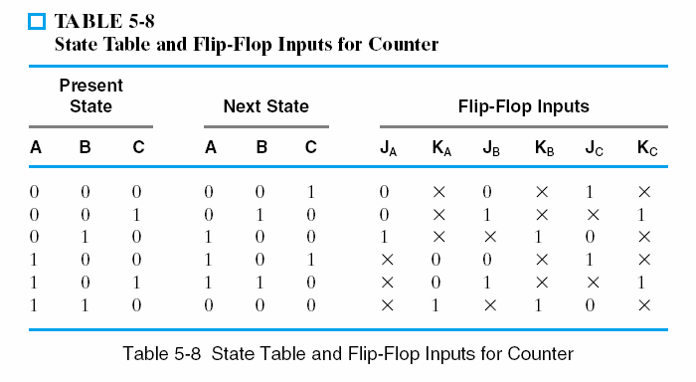
Example II

Slide 46
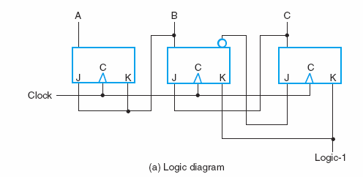
Example II .. Continue

Slide 47
Lecture End

